Slide 1
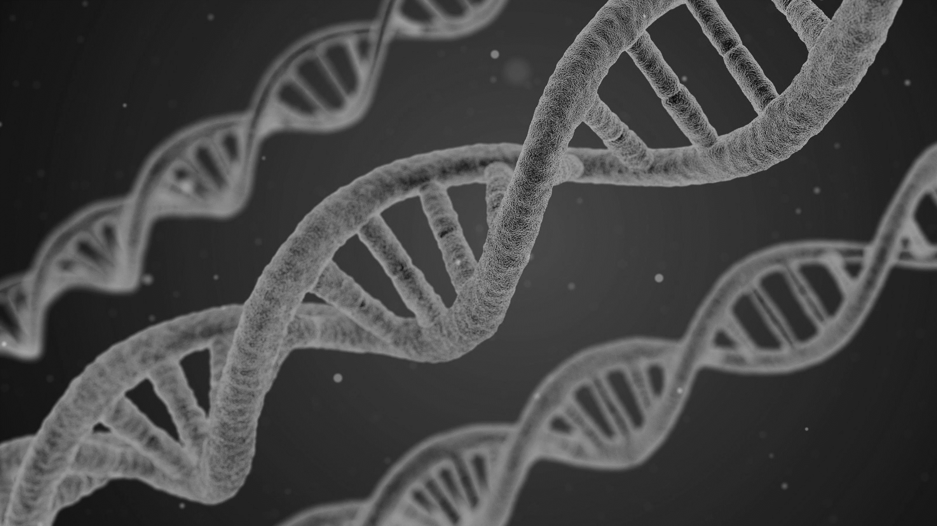
Azure Machine Learning for the
ABSOLUTE BEGINNER
Alexander Arvidsson
@arcticdba
2019
Artificial Edition
6-8 February

Slide 2
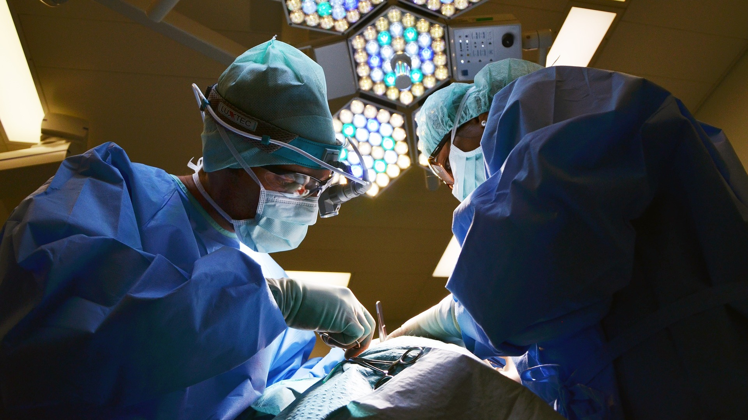

Slide 3

Introduce MACHINE LEARNING
Get STARTED with Azure
Machine Learning
Explore how to APPLY
machine learning CONCEPTS

Slide 4
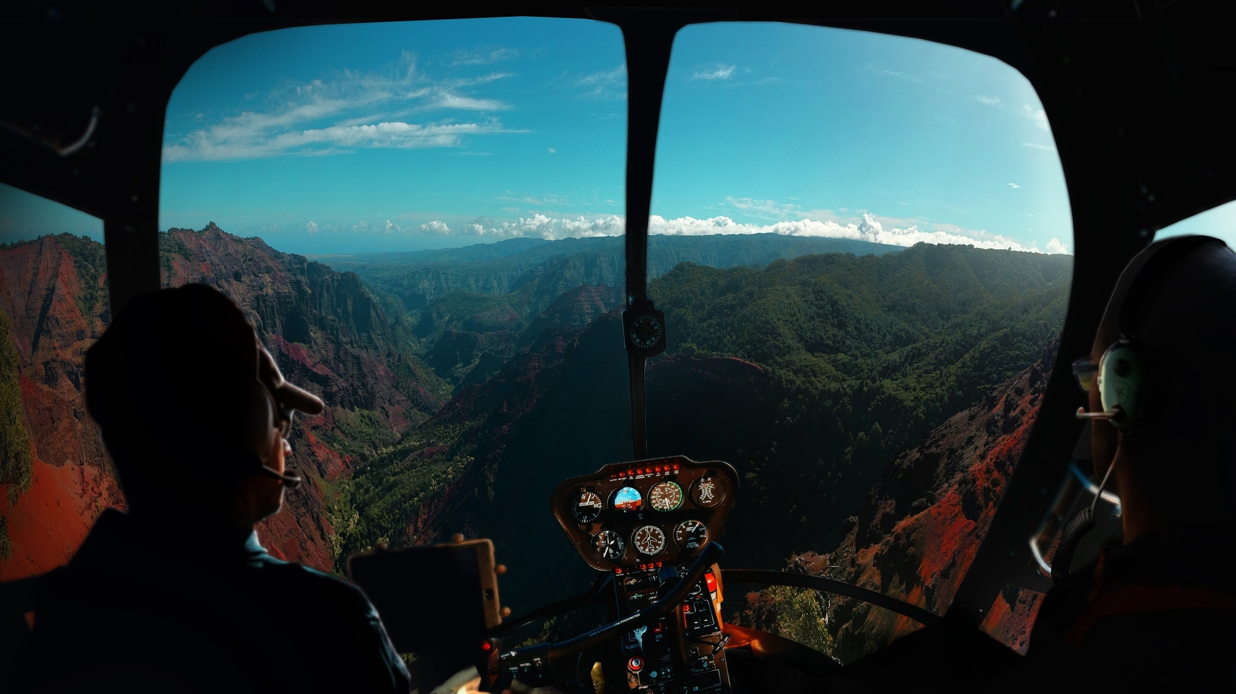

Slide 5
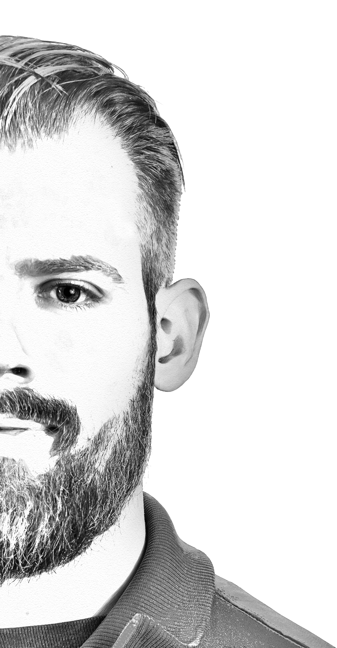



Principal Solutions Architect @ Atea
| Data Platform MVP | Speaker | Blogger |
| Podcaster | Pluralsight author |

Slide 6
“Machine learning (ML) is the scientific study of ALGORITHMS and STATISTICAL MODELS that computer systems use to PROGRESSIVELY IMPROVE their
performance on a SPECIFIC TASK.”

Slide 7
“Machine learning algorithms build a MATHEMATICAL MODEL of sample data, known as “TRAINING DATA”, in order to make predictions or decisions WITHOUT BEING EXPLICITLY programmed to perform the task.”

Slide 8
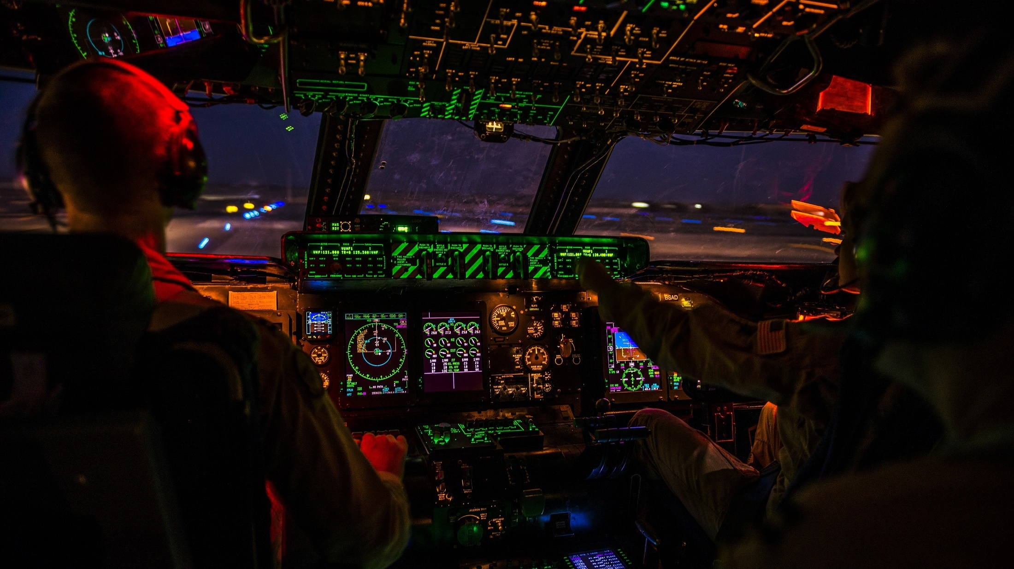

Slide 9






Slide 10
Supervised learning
Classification
Regression
Anomaly detection
Unsupervised learning
Reinforcement learning

Slide 11


Slide 12
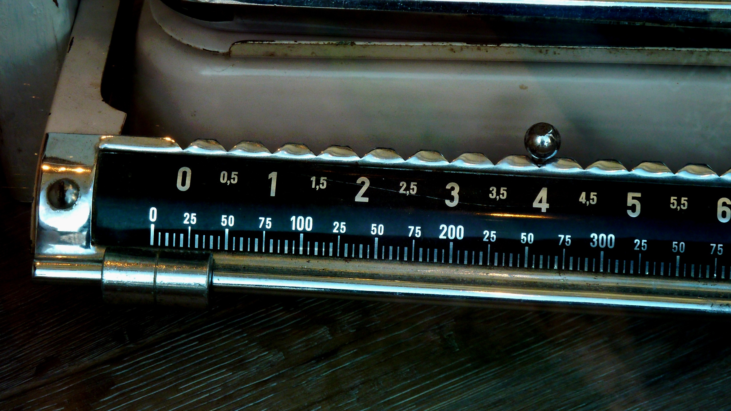

Slide 13
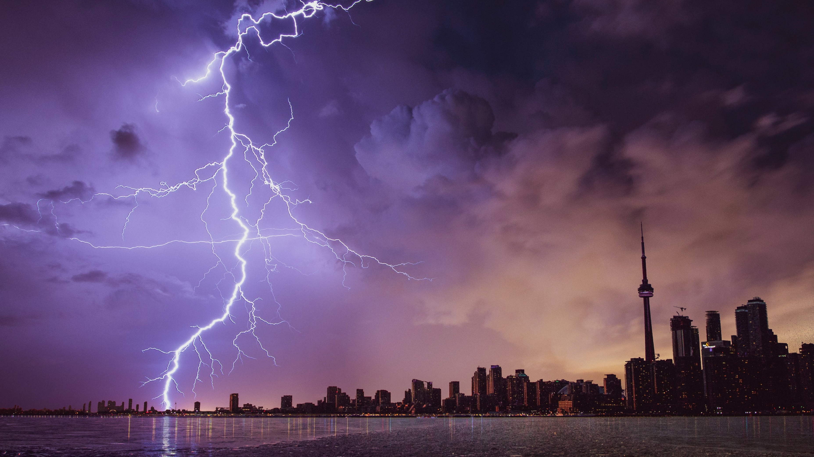

Slide 14


Slide 15
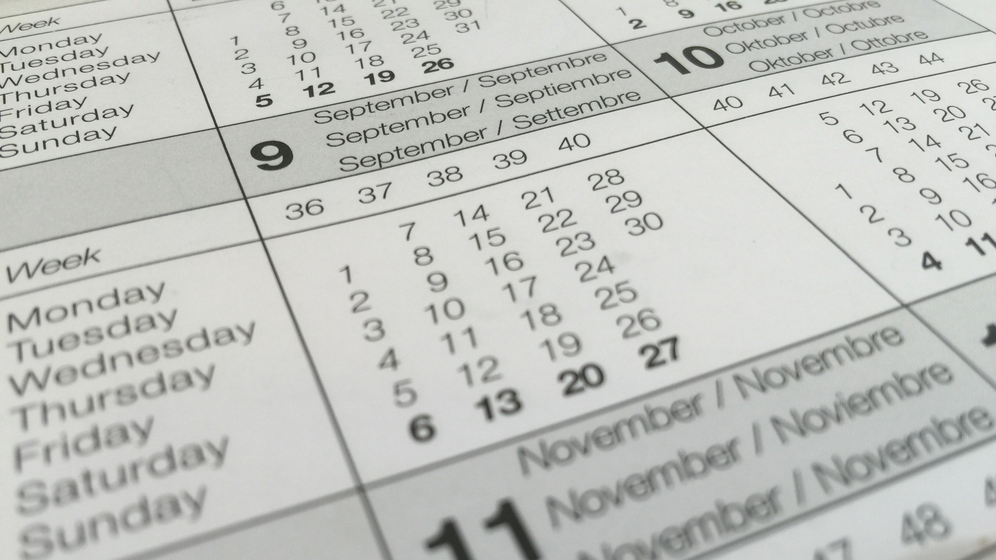

Slide 16
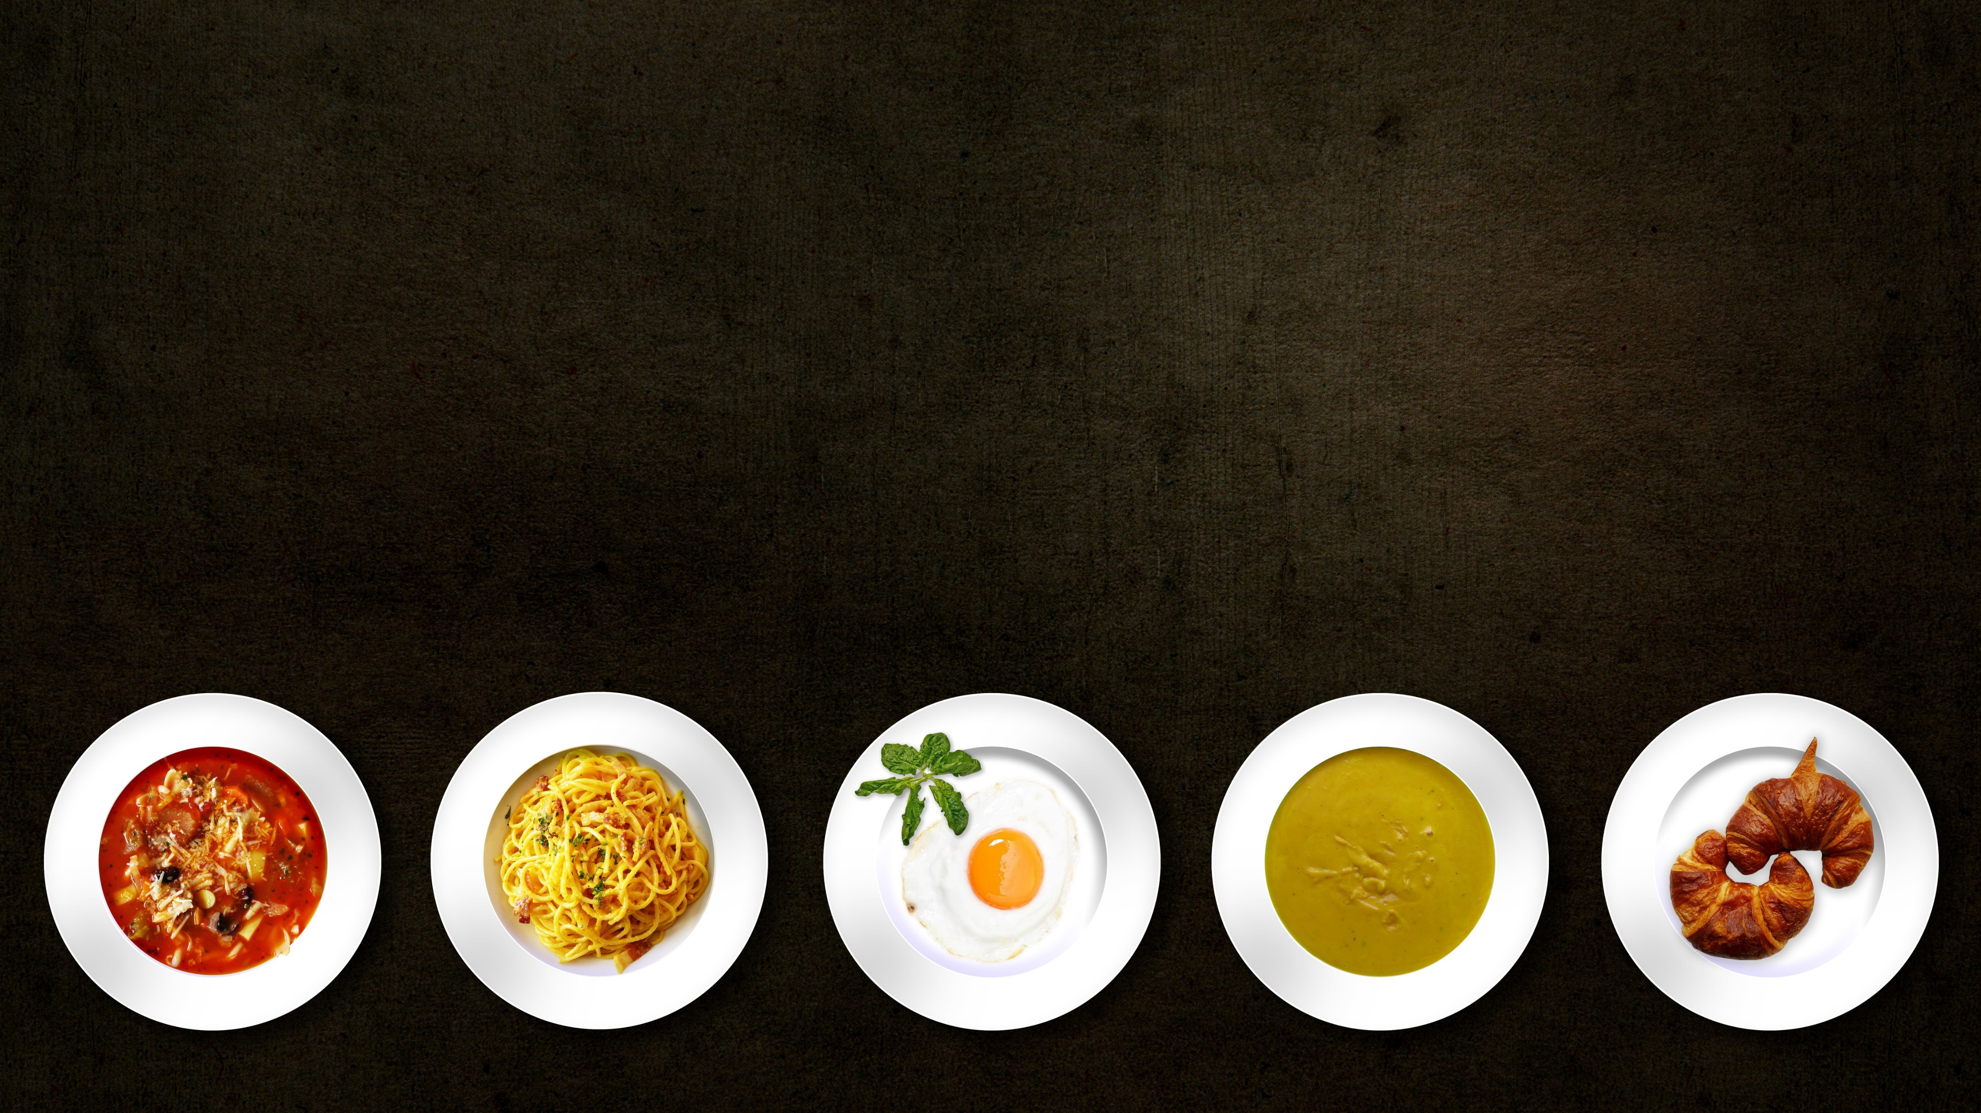

Slide 17
Using STATISTICAL MODELS to find PATTERNS to PREDICT outcomes where NO DATA EXISTS

Slide 18
Can I get a completely NEW recipe?

Slide 19
Which ALGORITHM is the best?

Slide 21
What is DATA then?

Slide 22
What does QUALITY mean?

Slide 23
How MUCH data do I need?

Slide 24
So how does it WORK?

Slide 25
Teaching the AI to LAND A PLANE
Letting the AI play TETRIS
Simulating riding a BICYCLE

Slide 26
Machine learning can be a bit
of a BLACK BOX

Slide 27
How to get STARTED?

Slide 29
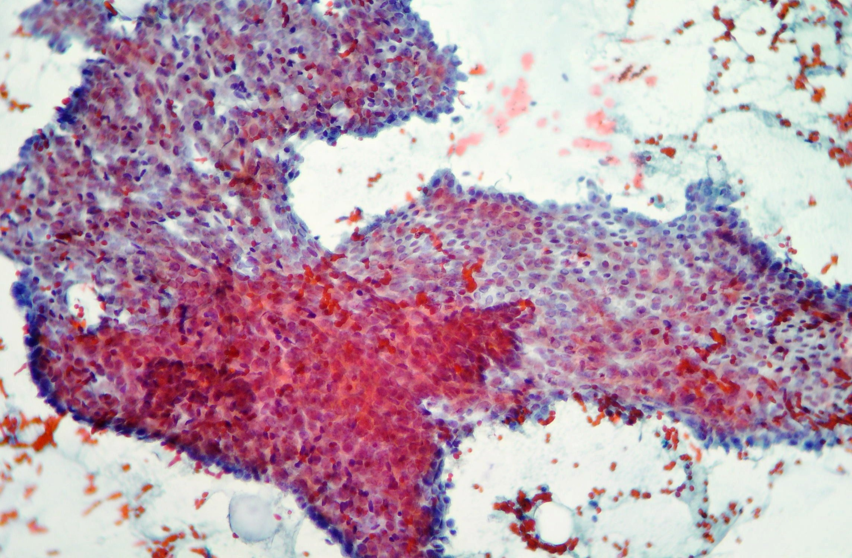

Slide 30
Column1 | Column2 | Column3 | Column4 | Column5 | Column6 | Column7 | Column8
842302 | M | 17.99 | 10.38 | 122.8 | 1001 | 0.1184 | 0.2776
842517 | M | 20.57 | 17.77 | 132.9 | 1326 | 0.08474 | 0.07864
84300903 | M | 19.69 | 21.25 | 130 | 1203 | 0.1096 | 0.1599
84348301 | M | 11.42 | 20.38 | 77.58 | 386.1 | 0.1425 | 0.2839
84358402 | M | 20.29 | 14.34 | 135.1 | 1297 | 0.1003 | 0.1328
843786 | M | 12.45 | 15.7 | 82.57 | 477.1 | 0.1278 | 0.17
84862001 | M | 16.13 | 20.68 | 108.1 | 798.8 | 0.117 | 0.2022
849014 | M | 19.81 | 22.15 | 130 | 1260 | 0.09831 | 0.1027
8510426 | B | 13.54 | 14.36 | 87.46 | 566.3 | 0.09779 | 0.08129
8510653 | B | 13.08 | 15.71 | 85.63 | 520 | 0.1075 | 0.127
8510824 | B | 9.504 | 12.44 | 60.34 | 273.9 | 0.1024 | 0.06492
8511133 | M | 15.34 | 14.26 | 102.5 | 704.4 | 0.1073 | 0.2135
851509 | M | 21.16 | 23.04 | 137.2 | 1404 | 0.09428 | 0.1022

Slide 31
Column1 | Column2 | Column3 | Column4 | Column5 | Column6 | Column7 | Column8
842302 | M | 17.99 | 10.38 | 122.8 | 1001 | 0.1184 | 0.2776
842517 | M | 20.57 | 17.77 | 132.9 | 1326 | 0.08474 | 0.07864
84300903 | M | 19.69 | 21.25 | 130 | 1203 | 0.1096 | 0.1599
84348301 | M | 11.42 | 20.38 | 77.58 | 386.1 | 0.1425 | 0.2839
84358402 | M | 20.29 | 14.34 | 135.1 | 1297 | 0.1003 | 0.1328
843786 | M | 12.45 | 15.7 | 82.57 | 477.1 | 0.1278 | 0.17
84862001 | M | 16.13 | 20.68 | 108.1 | 798.8 | 0.117 | 0.2022
849014 | M | 19.81 | 22.15 | 130 | 1260 | 0.09831 | 0.1027
8510426 | B | 13.54 | 14.36 | 87.46 | 566.3 | 0.09779 | 0.08129
8510653 | B | 13.08 | 15.71 | 85.63 | 520 | 0.1075 | 0.127
8510824 | B | 9.504 | 12.44 | 60.34 | 273.9 | 0.1024 | 0.06492
8511133 | M | 15.34 | 14.26 | 102.5 | 704.4 | 0.1073 | 0.2135
851509 | M | 21.16 | 23.04 | 137.2 | 1404 | 0.09428 | 0.1022

Slide 32
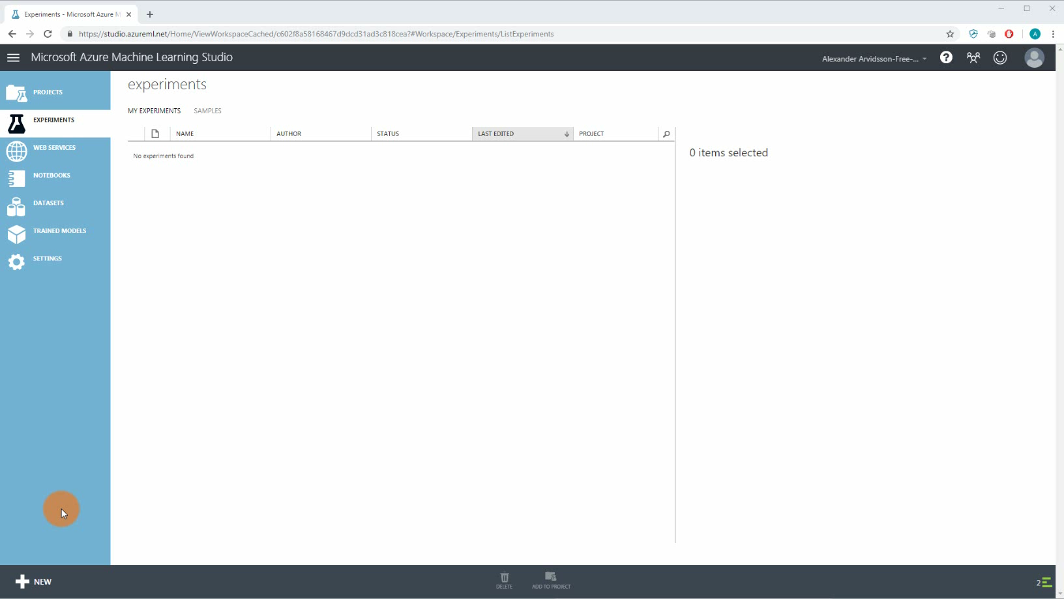
Getting started
ML studio – automatgenererade modeller

Slide 33
What would be the NEXT step?

Slide 34
How can machine learning be IMPLEMENTED?

Slide 35



Slide 36
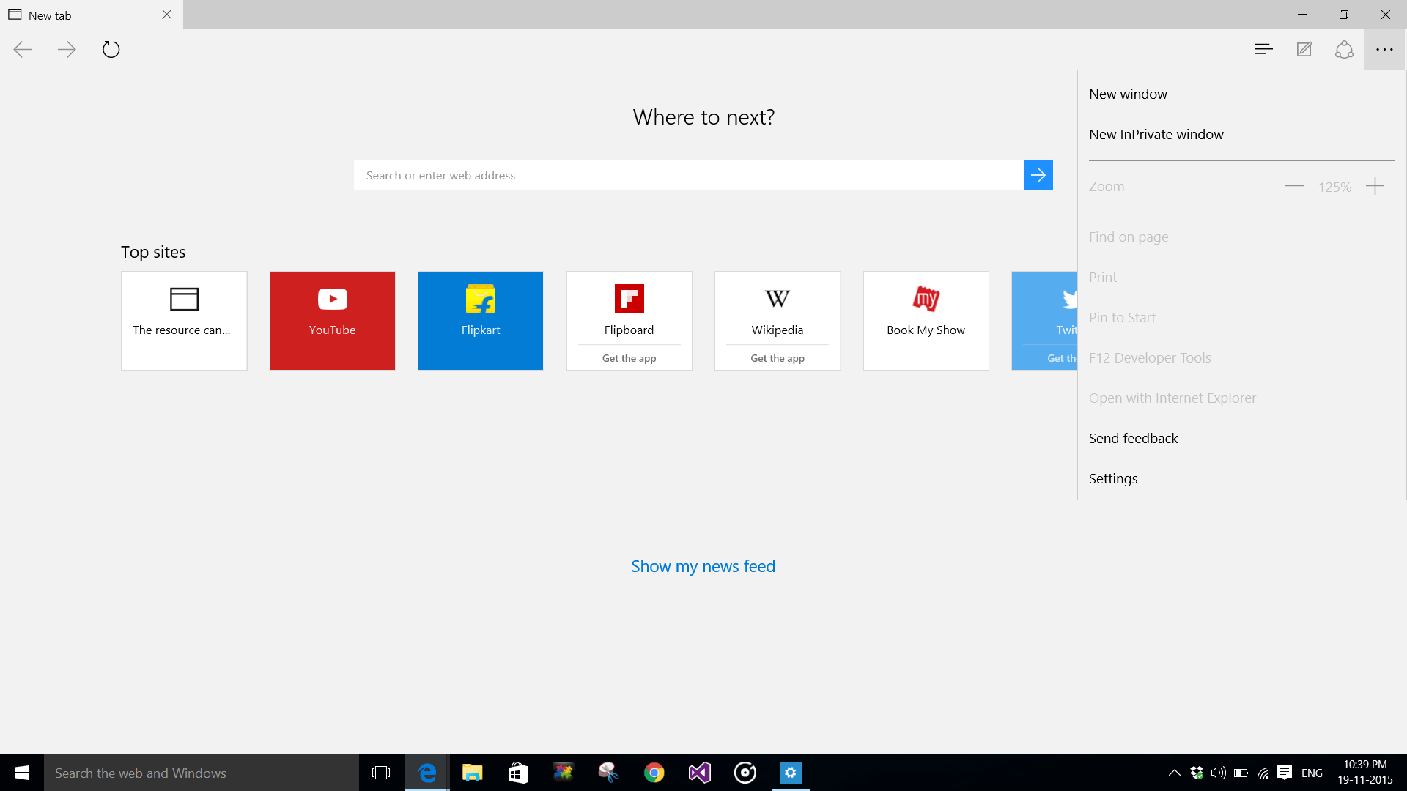

Slide 37
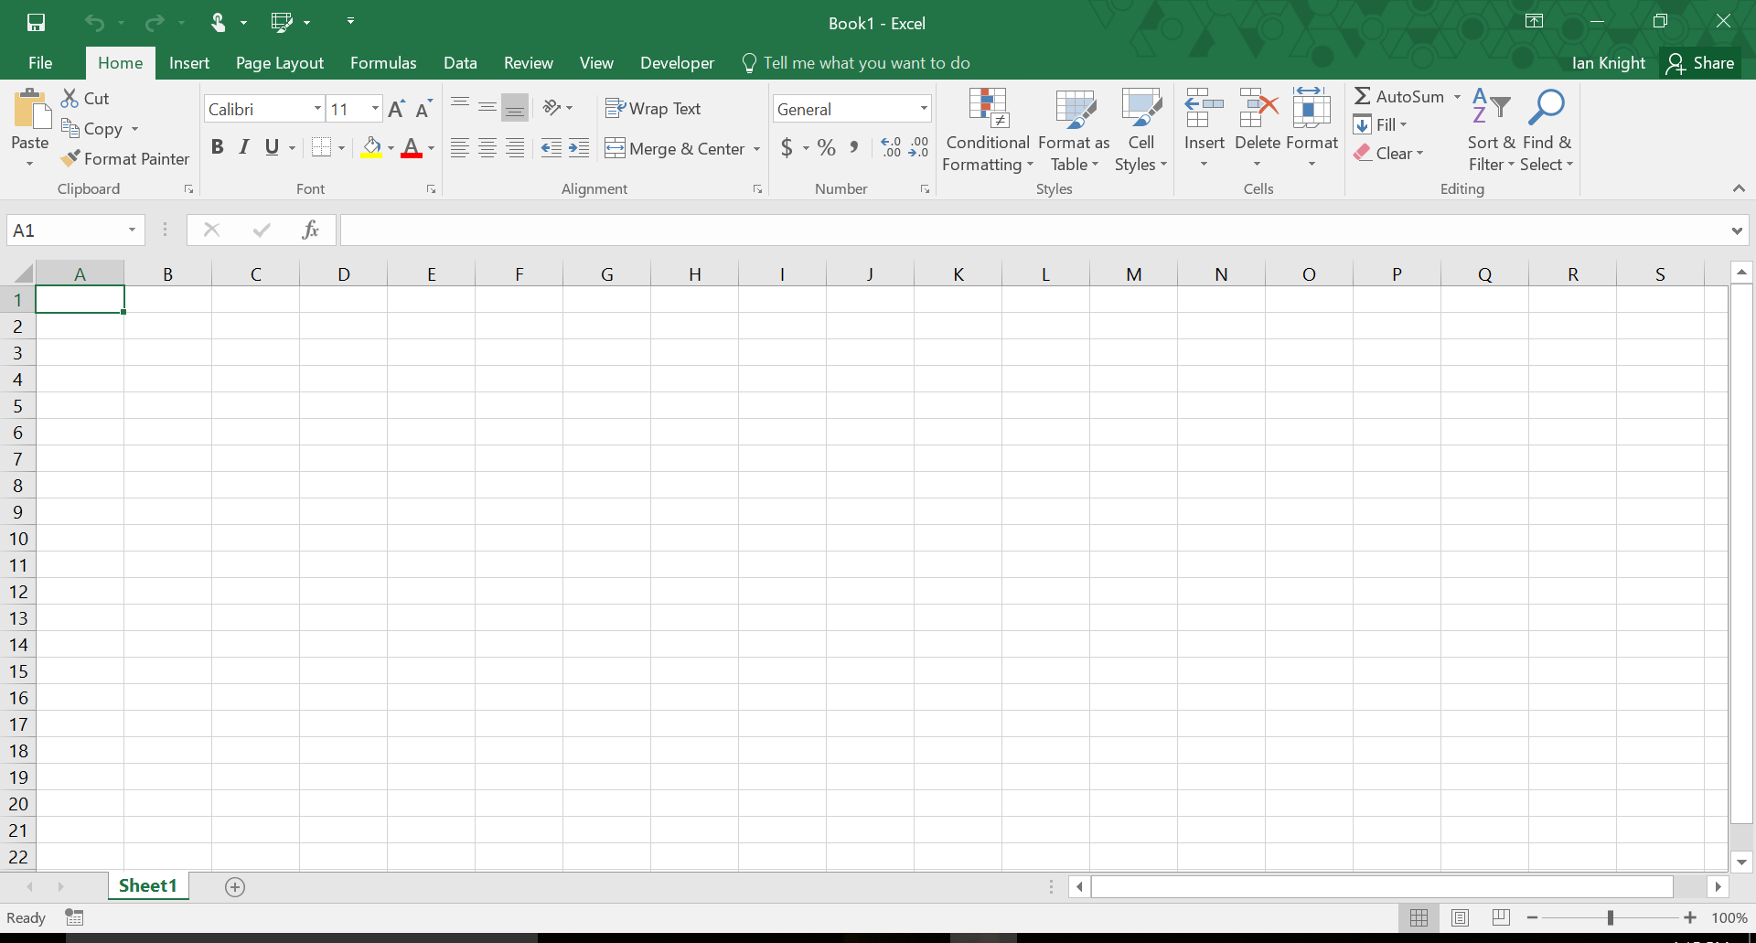

Slide 38


Slide 39
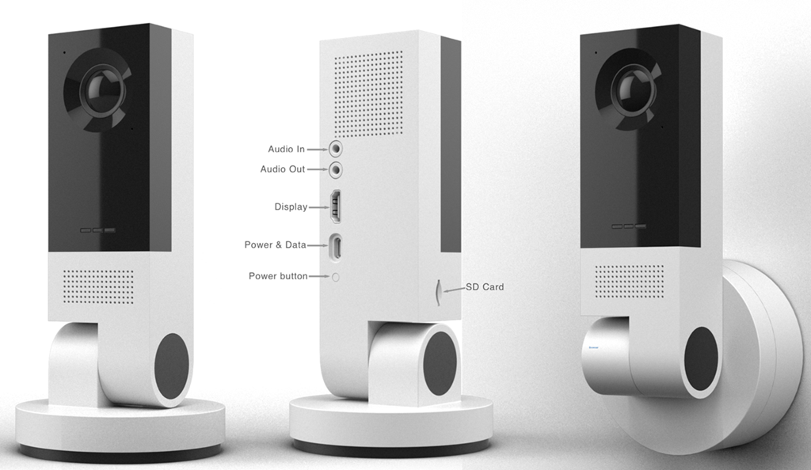

Slide 40
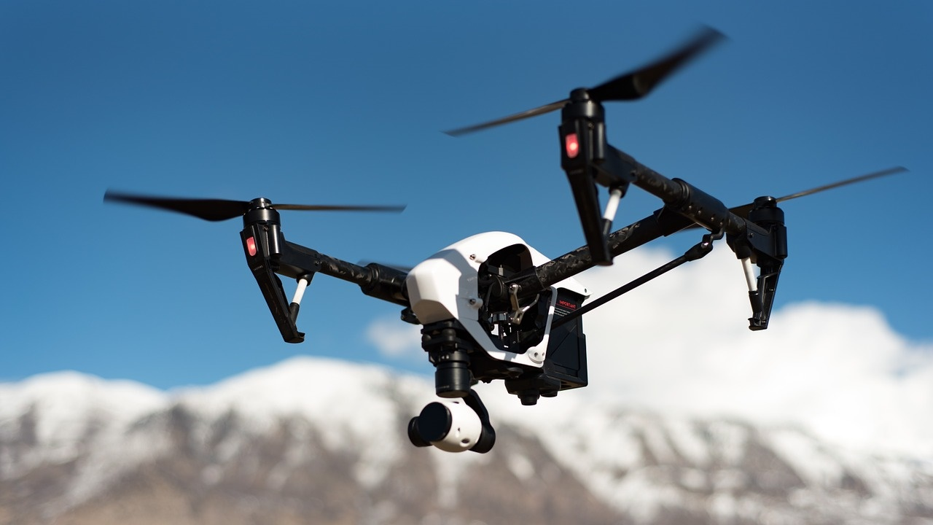
EDGE SERVICE

Slide 41
How can machine learning be
USED?

Slide 42
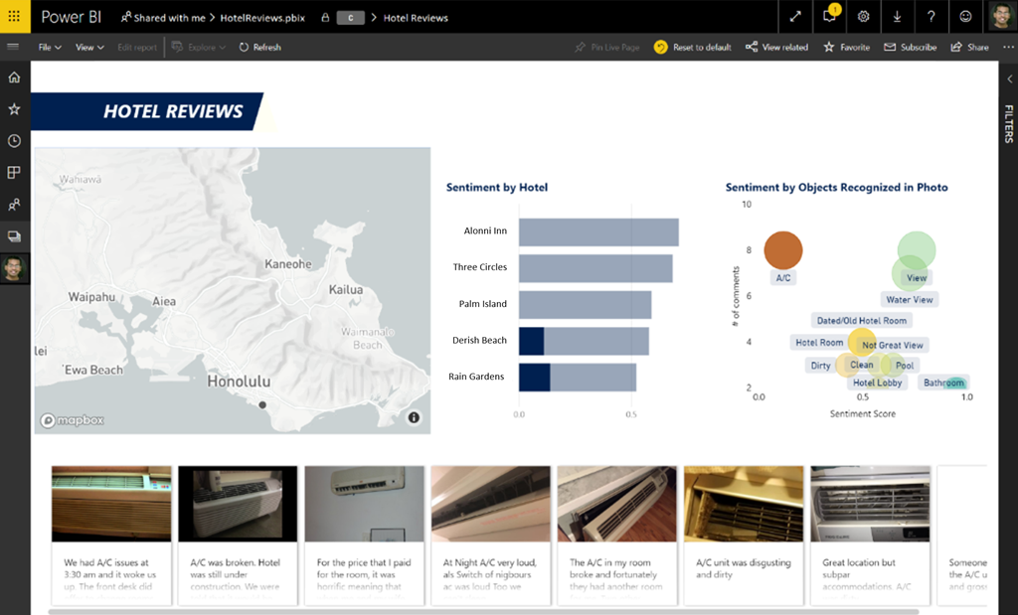

Slide 43
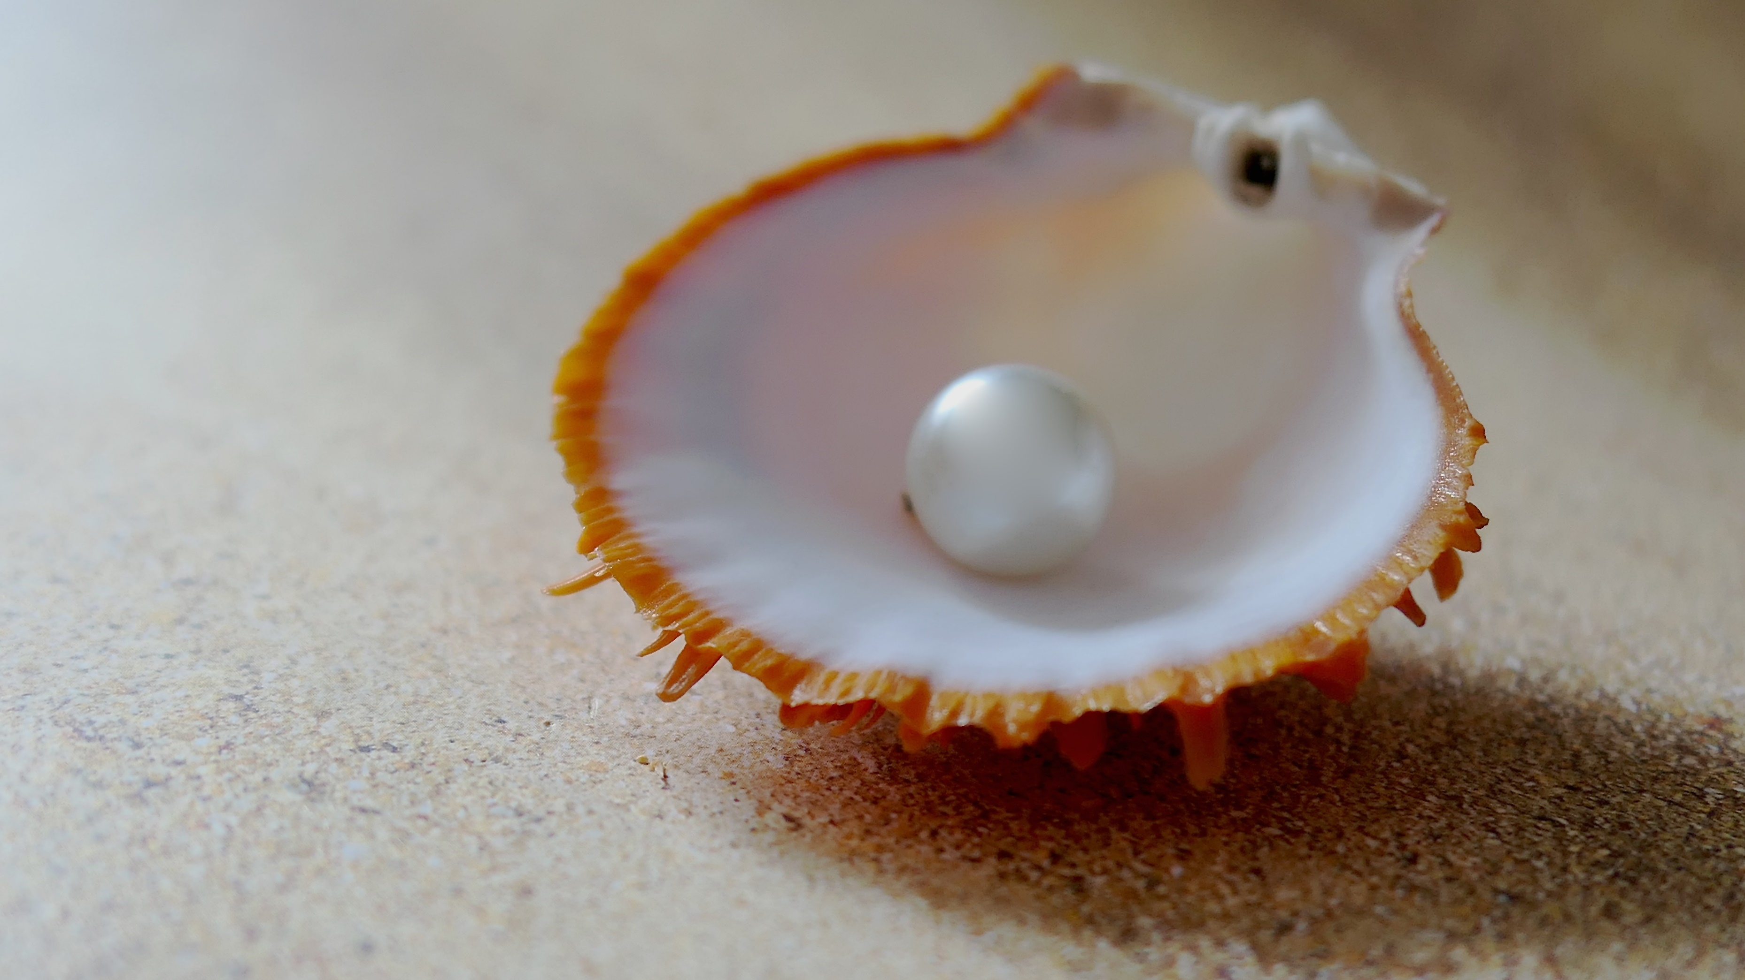

Slide 44
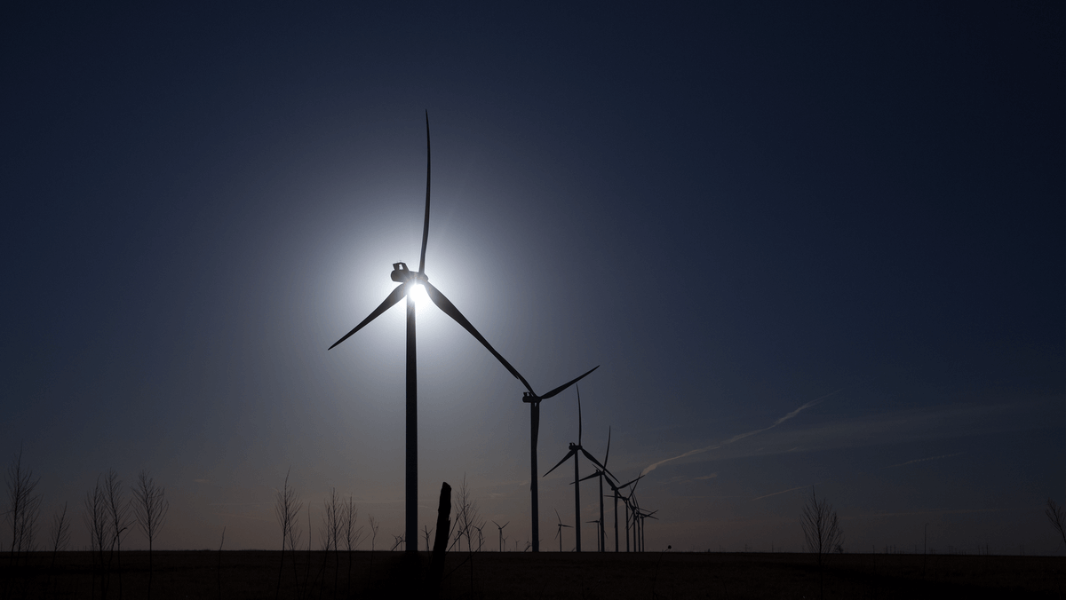

Slide 45
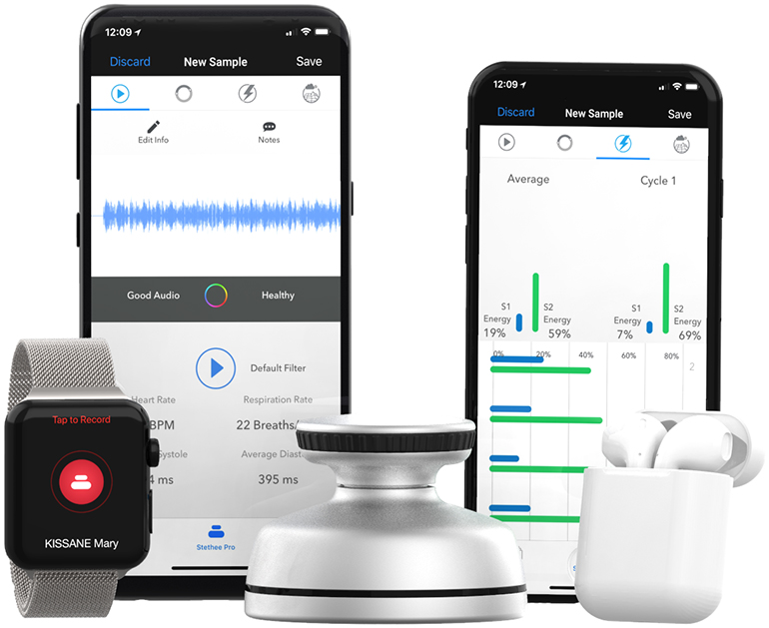
Copyright© 2018 M3dicine

Slide 46
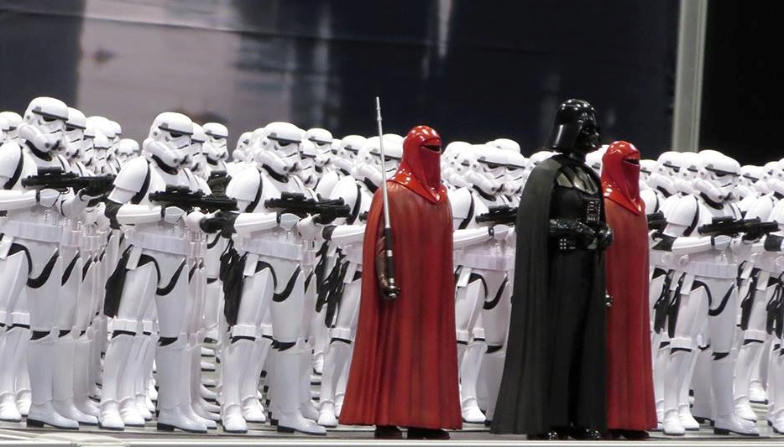
?
?
Frågor

Slide 47
Machine learning is a TOOL
Azure is the perfect TOOLBOX
We have only scratched
the SURFACE

Slide 48


Slide 49
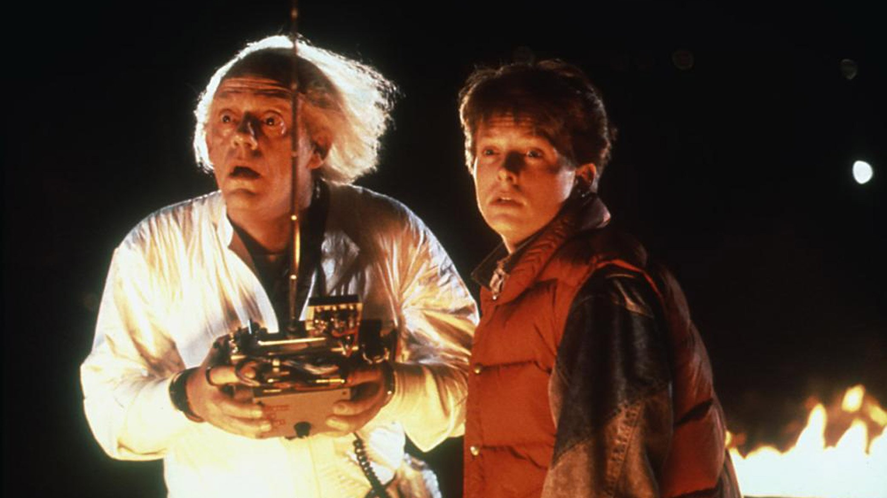
Copyright© Universal Studios. All rights reserved.

Slide 50




Thank you!
https://www.arcticdba.se
@arcticdba
alexander@arcticdba.se
Knee-Deep in Tech

Slide 51
Slides and demos from the conference will be available at
https://github.com/nordicinfrastructureconference/2019

